Slide 1
Credit Union Connections
Ridiculously Wonderful- Ignite Team
Allie Foley, Ben Dexter, James Cashman, Kimmie Davis

Slide 2
The Problem
The corona virus has reshaped how we connect with others.
Traditional in person networking was postponed, canceled, or became virtual.
Even before the pandemic, at events like the ICUL annual convention, only about 7% of credit union employees attended.
Millennials and Generation Z employees are more accustom to connecting through social media platforms instead of being in person.
The work force is quickly becoming made up of Generation z and Millennials as more Baby Boomers retire.
Don’t want to lose the cooperative nature of credit unions.
New innovative ways of Networking for Credit Unions is needed!
Notes:
We all know the Pandemic has affected everything we do. The way we travel, the way we work and the way we communicate. Perhaps the most important thing that the pandemic affected was our ability to network. We can all agree that what makes the Credit Union industry unique is our cooperative spirit at the heart of our foundation. We utilize our strengths together. We serve each other, by providing one other with resources and ideas.
We team up in groups such as ignite and the Indiana credit union league to believe in a common purpose of people helping people.
However, without this networking, we are all alone. Without networking the cooperative foundation will fail. We then become competitors and are no different from the banks.
Networking is especially hard for the younger generations. When we were born we had unlimited ways to communicate--- yet are the most introverted generations. 59% of millennials consider themselves introverted. So these big conventions, vendor tables, dinners out with strangers, are 100% NOT what we look forward. Thank you to COVID for allowing us to work from home, curled up under blankets, comfortably socially awkward awaiting the end of the world. We were at peace, but for the last 18 months, we were getting left behind, while Baby Boomers are retiring at a record pace!
Now we are here, we have this gap, we need to fill. Only 6% of worldwide employment is made up of the Boomer generation, and 59% is made up of age 39 to 25. So I have to ask Is 59% of your credit union management team under the age of 40, and are they actively networking with other Credit Unions?
How can we bridge the gap for millennials and Generation Z to see Credit Unions are their long time Career path? How can you bring your introverted millennials out of their shell and introduce them to people who are just like them. Believe me, two introverts in a room, don’t make great conversation.
Well let me show you what Allie and I have dreamed up.
A solution to this problem, A dream of a Social Network- for Indiana Credit Unions.
A blend of a social App, A linked In Experience, An open forum, a user blog and a virtual networking experience. For Credit Unions, By Credit Unions.
I want to introduce you to Credit Union Connections

Slide 3
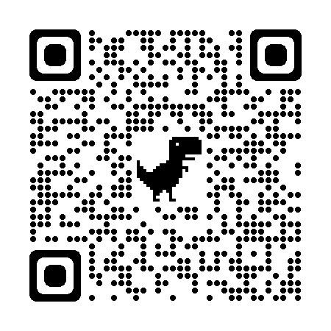
Social Network For Indiana Credit Unions
Credit Union Connections
Engagement style like a Networking Event
Accessible like a Social App
An open forum for discussion like a Users Conference
A unique experience for all levels of Credit Union employees with various skills, backgrounds, demographics, interests, strengths, education and job duties.

Slide 4
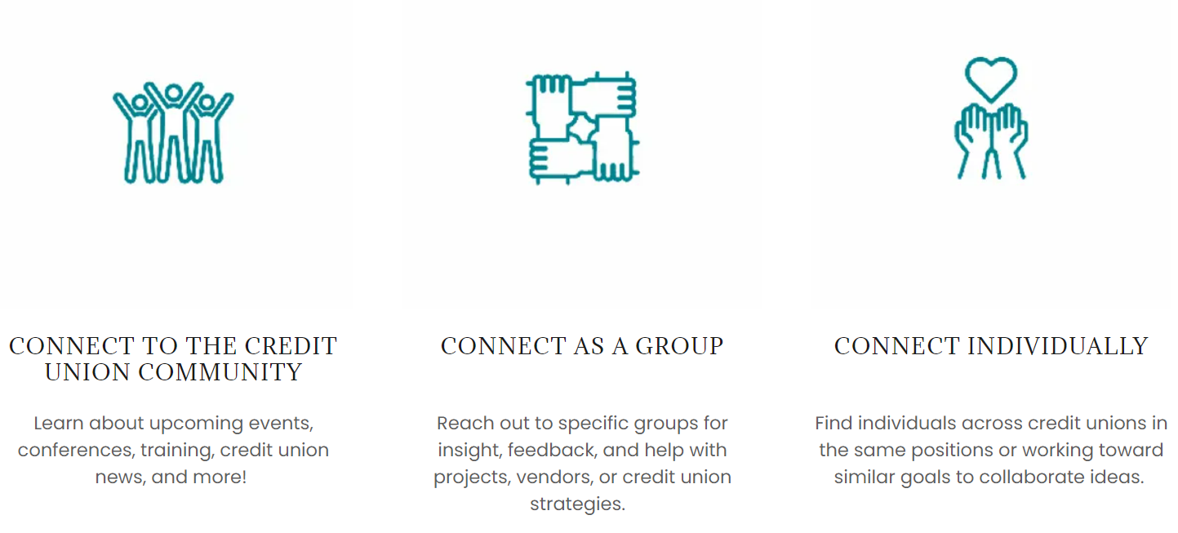

Slide 5
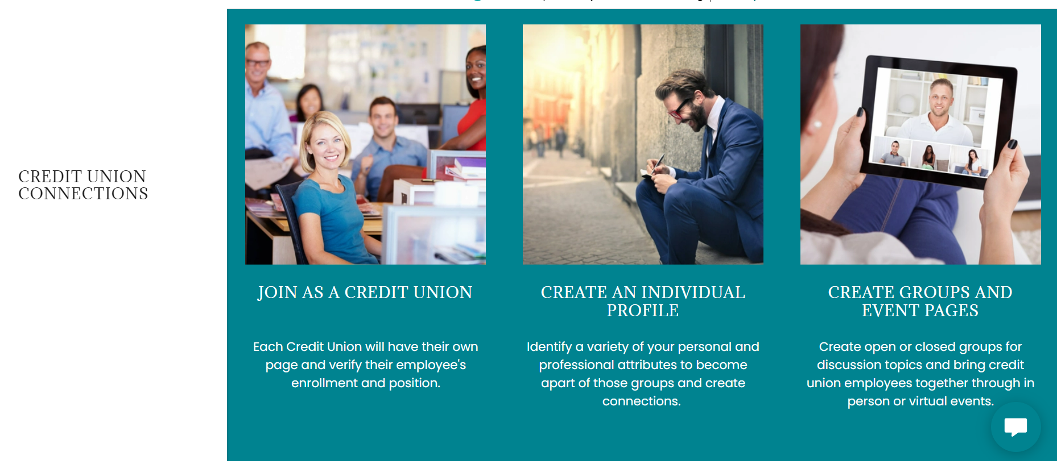
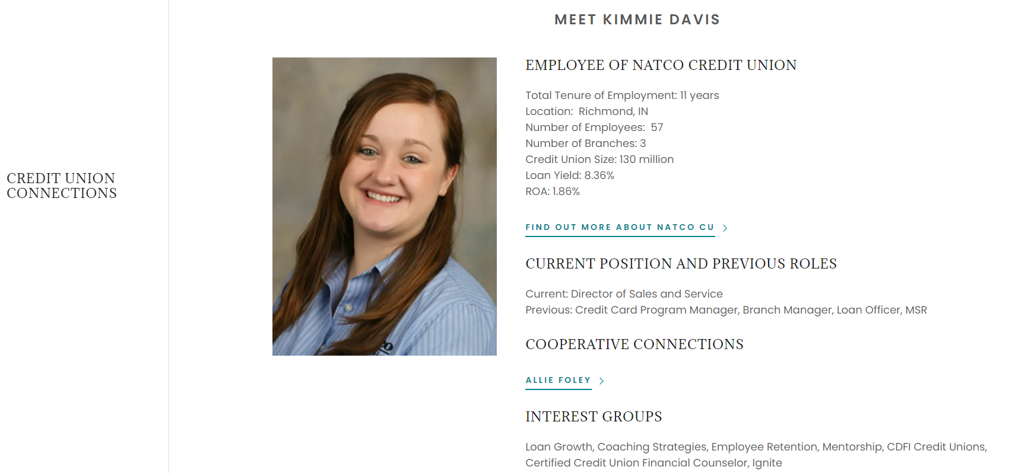

Slide 6
Virtual Networking Events
Think about speed dating…for Work.
Quarterly Virtual Networking Events
Conversation Sparkers
Customized Matches based on the User Profile
7- min sessions x 4 rounds in a 30-minute event
4 new matches every quarter
The connection can last a lifetime
What if within your CU networking was a Job Duty?
What if within your CU Mentoring was an exit strategy?
What if connecting with like positions at other CUs was a reliable fun resource for your staff?
Notes:
How do we get people to really get to know each other in 7 min4 new matches every quarter
The connection can last a lifetime
What if within your CU networking was a Job Duty?
What if within your CU Mentoring was an exit strategy?
What if connecting with like positions at other CUs was a reliable fun resource for your staff?
s?
Hosted Virtual networking events held quarterly
predetermined talking prompts to spark quality conversation
Random pairings based on user profile set up and topic preferences
7- min sessions x 4 rounds in a 30-minute event
The user leaves with 4 new Credit Union connections each quarter
The conversations can continue within the app in an instant messenger type communication method

Slide 7
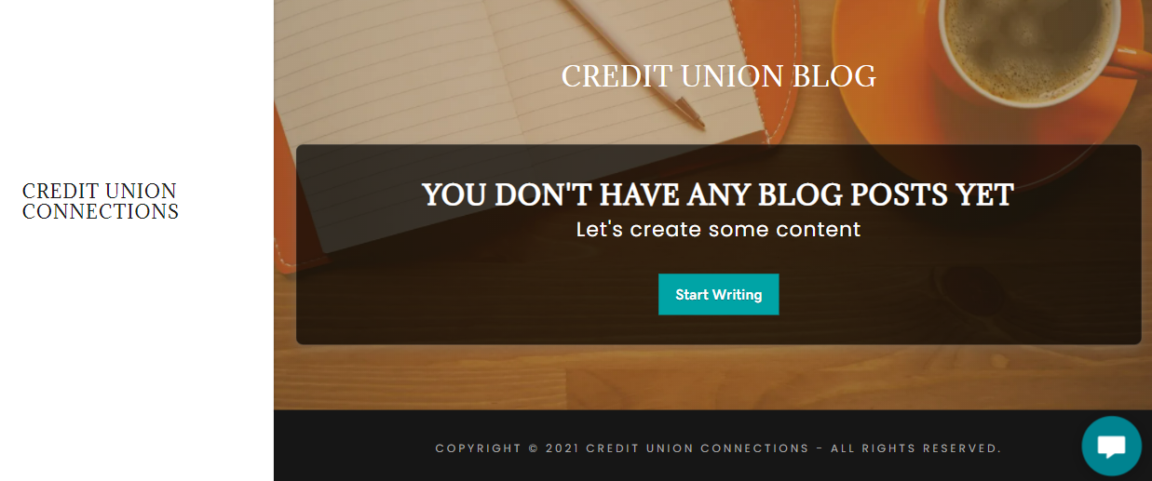
Open Virtual Collaboration
Reach out to individuals with shared interest or responsibilities
Make blog post or pose questions to specific groups for guidance
Share news, training, and more to the entire credit union community
Notes:
So what if speed dating isn’t for you, or you aren’t ready to connect individually yet, we will also have open virtual collaboration. You can reach out to individuals who share your same interests or same responsibilities.
There will be blog posts or group discussion boards where you can ask questions, or start surveys.
This is a productive way to allow employees to feel heard, they can express their ideas and feedback with peers.
So what if dreams could become reality… What would need to happen next

Slide 8
Next Steps:
If Dreams could turn into Reality and the platform was created.
Invite all Indiana credit unions to join and encourage Ignite Alumni to Create User Profiles.
Create and schedule various virtual events like the CU professional speed dating event.
Notify users of the fun virtual events.
When its time, login on your computer or grab your mobile device!

